Slide 1

PL/SQL

Slide 2
WHAT ARE THE FUNCTIONALITY OF PL/SQL ???
PL/SQL includes procedural language elements like conditions and loops. It allows declaration of constants and variables, procedures and functions, types and variable of those types and triggers.
It can support Array and handle exceptions (runtime errors).
You can create PL/SQL units like procedures, functions, packages, types and triggers, etc. which are stored in the database for reuse by applications.
With PL/SQL, you can use SQL statements to manipulate Oracle data and flow of control statements to process the data.
PL/SQL is not case sensitive.

Slide 3
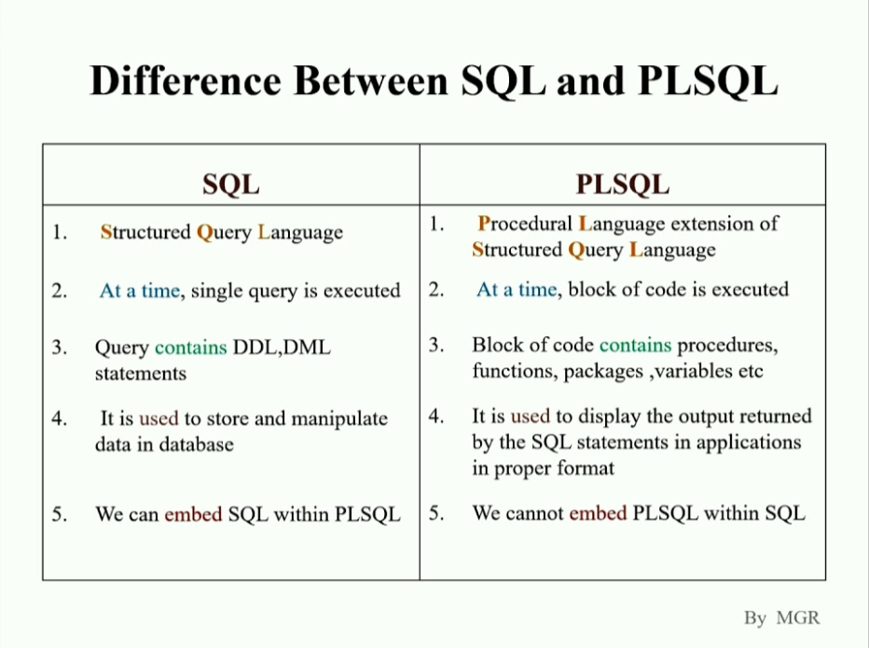

Slide 4
Here's a simple example to create a procedure that calculates the square of a number:
CREATE OR REPLACE PROCEDURE calculate_square(num IN NUMBER) IS
result NUMBER;
BEGIN
result := num * num;
dbms_output.put_line('The square of ' || num || ' is ' || result);
EXCEPTION
WHEN others THEN
dbms_output.put_line('Error: ' || SQLERRM);
END;
EXEC calculate_square(5);
Output
The square of 5 is 25

Slide 5
TCL COMMANDS IN SQL

Slide 6
T c l commands (transaction control Language)
Transactions group a set of tasks into a single execution unit. Each transaction begins with a specific task and ends when all the tasks in the group are successfully completed. If any of the tasks fail, the transaction fails.
Commit
Save Point
Roll Back

Slide 7
COMMIT
The COMMIT command permanently saves all changes made during the current transaction.
-- Start transaction
BEGIN TRANSACTION;
UPDATE STUDENT SET STUDENT_NAME = ‘Maria’ WHERE STUDENT_NAME = ‘Meena’;
COMMIT;

Slide 8
ROLLBACK
The ROLLBACK command is used to undo transactions that have not been committed to the database. It reverts the database to the last committed state.
-- Start transaction
BEGIN TRANSACTION;
-- Delete order with order_id 5
DELETE FROM Orders WHERE order_id = 5;
-- After some operations, decide to rollback
ROLLBACK;

Slide 9
SAVEPOINT
-- Start transaction
BEGIN TRANSACTION;
-- Update customer 1's age
UPDATE Customers SET age = 32 WHERE customer_id = 1;
-- Create a savepoint named SP1
SAVEPOINT SP1;
-- Update customer 2's country
UPDATE Customers SET country = 'Canada' WHERE customer_id = 2;
-- Create another savepoint named SP2
SAVEPOINT SP2;
-- If an error occurs, you can rollback to SP1 or SP2
The SAVEPOINT command allows you to set a point within a transaction to which you can roll back without affecting the entire transaction

Slide 10
-- Start a transaction
BEGIN TRANSACTION;
-- Update some data
UPDATE employees SET salary = salary * 1.1 WHERE department_id = 10;
-- Check if everything is correct
SELECT * FROM employees WHERE department_id = 10;
-- If everything is fine, commit the changes
COMMIT;
-- If there's an issue, rollback the transaction
ROLLBACK;

Slide 11
THANK YOU
HOPE YOU UNDERSTAND WELL

